Slide 1

Ch. 10. Problem Solving in Groups CLO – 04 Identify workplace conflict and develop resolution strategies
EE Communication Skills (SS-2010) Spring 2025

Slide 2
Learning Objectives (CLO - 04)
Understand Steps in Systematic Problem-Solving Process
Inspect the Leadership Function in Group Problem Solving
Differentiate Group Member Responsibilities in Meetings
Evaluate How Can Groups Communicate Solutions to Others
Activity #12 Speaking in a group context (10 marks) (CLO – 04)

Slide 3
In workplace contexts, groups come across problems that need to be resolved
Meetings are conducted to have member inputs and solution offerings
Informed decisions then are taken to resolve the issues and achieve the goals
If the problem-solving mechanism is not systematically adapted, failures set in
There is time and resources wastage, a frequent show of blame-game causing inefficiency/ failure to achieve the goals
Leadership skills effectively manage group interactions, responsibility sharing, and have decision making/ action implementation

Slide 4
The Problem-Solving Process
Groups use systematic approaches to solve problems in contexts
They refine, accept, reject, modify, combine ideas, and circle back to previous discussion as they go along
The organized groups are more efficient at effective solutions/ productivity
They may use:
The linear-process approaches (highly structured – more efficient)
Spiral-sequence activities (problem-solving criteria develops as they go along – less efficient)

Slide 5
1. Steps in Systematic Problem-Solving Process
Groups making high quality decisions perform six tasks/ steps (Dewey, 1933)
Identify and Define the Problem
Analyze the Problem
Determine/ Develop Criteria for Judging Solutions
Identify Alternative Solutions
Evaluate Solutions and Decide
Implement the Agreed-Upon Solution(s)

Slide 6
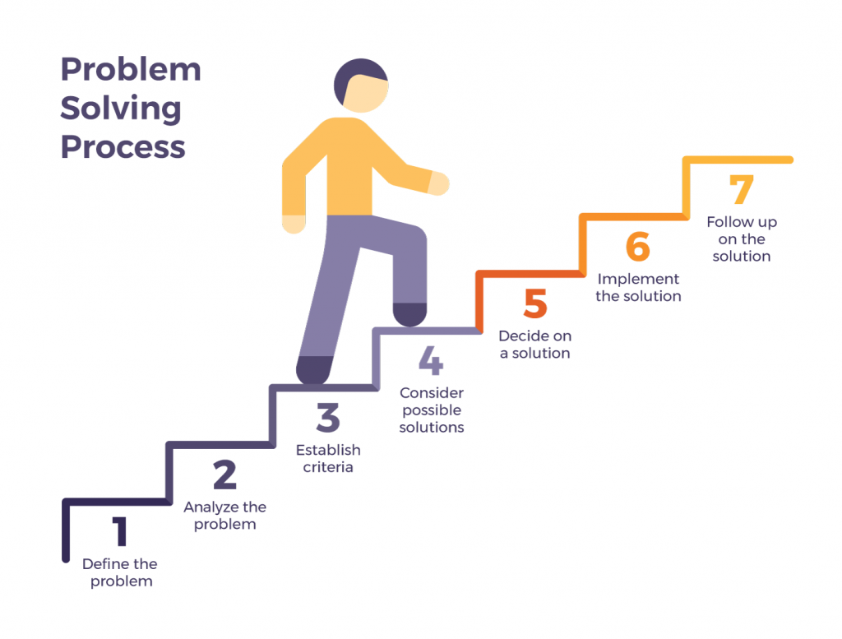

Slide 7
1) Identify and Define the Problem
Identify the problem as apparent or underlying. Formally write it down.
An effective problem-definition is stated as a question of:
Fact – what is true/ factual/ data supported
‘What percentage of employees use public transport to reach the office?’
Value – whether the problem is right/ moral/ good/ just/ worthy
‘What is the effective way to induct new staff?’
Policy – what action should be taken/ rules to adopt
‘How can we increase our production before the winter sets in?’

Slide 8
2) Analyze the Problem
Find out as much information as possible about the problem
Share this information among group members
Very often, a group member already has an experience/ important Information/ experts
Members may be assigned to search more information through published documents
Surveys/ interviews could also be conducted to gather maximum relevant information
The problem is analyzed through multiple aspects/ sentiments/ experiences…

Slide 9
3) Determine Criteria for Judging Solutions
Criteria are the standards/ measures used for judging the merits of proposed solutions
They provide a road-map how the group will evaluate merits of each alternative solution
Criteria clarity before offering solutions helps make stronger decisions
Once criteria is set, the group needs to prioritize the solution list to make a strong plan

Slide 10
4) Identify Alternative Solutions
Deciding effective solution(s) would depend upon the range of possible solutions to choose from
The most positive activity is to have brainstorming session(s)
These sessions invite creativity, alternatives, suspending judgment, combining or adapting an idea, free-will-contributions, no criticism
During brainstorming stage, a member records all events/ ideas:
Video-recording, white/ smart board, projectors, note-pads,…
Generally, more than 20 ideas/ solutions are quickly contributed

Slide 11
5) Evaluate Solutions and Decide
With the list of possible solutions at hand, the group evaluates and decides the best solution with no/ minimum losses
Solution comparisons are made against the criteria
Discussions/ healthy criticism is followed
Expert opinions/ experiences are considered before final decision
Five methods are commonly used to reach a group decision:
The expert opinion method
The average group opinion method
The majority rule method
The unanimous decision method
The consensus method

Slide 12
6) Implement the Agreed-Upon Solution
The group takes responsibility to implement the agreed-upon solution
Recommendations are made how to implement decision(s)
All details are filled in and are documented (e.g., meeting minutes)
Responsibilities to carry out the decision are distributed
Time frames are set (general and specific)

Slide 13
7) Follow Up on the Solution (Added Component)
The group follows up the efficiency and sustainability of the solutions
The process leads to improve quality and efficacy of the solution
Helps in self-assessment
Ensures quality and branding
Leads to innovation and expansion

Slide 14
In-Class Activity: Not Graded – discussion only
Have you ever worked as a member in a group?
Identify any problem(s) that the group encountered.
Did the group adapt linear or spiral processes to solve the issue?
What was your role in the group?
How did the group interact to extract multiple solutions?
Did your opinion/ input get any attention? If not, reasons?
Was the problem and its solutions documented?
Did the group fairly treat its members? If not, possible reasons?

Slide 15
2. Inspect the Leadership Function in Group Problem Solving
Leadership is a set of functions that can be performed by one, more than one, or all group members at various times
Leadership is a shared activity among members having different strengths and expertise to perform a function
A group may have a formal leader, but actually all group members emerge informally, at their turns, to execute their roles in a challenge
A role is a specific pattern of behavior group members perform based on their skills and expertise
There are three sets of leadership roles:
Task Roles
Maintenance Roles
Procedural Roles

Slide 16
Shared Leadership Roles
Task Roles:
Help the group acquire, process or apply information that contributes directly to task completion
High quality, most relevant information is provided
Other members are probed for ideas
Provided content is analyzed and scrutinized

Slide 17

Shared Leadership Roles
Maintenance Roles:
Sets of behaviors that help the group to develop and maintain cohesion, commitment, and positive working relationships
Everyone gets an opportunity to share ideas/ inputs
No member dominates the others
Tension is released through fun activities and relaxation
Members would be supporters, interpreters, harmonizers, mediators

Slide 18

Shared Leadership Roles
Procedural Roles:
Sets of behaviors that directly support the group process
Provide logistical support, keep records of accomplishments, manage group interactions
Logistic coordinators provide for appropriate spaces, equipment, supplies
Expediters keep track of what the group is trying to accomplish, help move agenda, mediate any deviations
Gatekeepers manage the flow of conversations, ensure equal participation, no one dominates

Slide 19
3. Differentiate Group Member Responsibilities in Meetings
Making Meetings Effective: Saving up to 6 hours per week
Guidelines for Meeting Leaders: (before the meeting)
Prepare and distribute an agenda (an organized outline of information and decision items to be covered in a meeting. (Refer to Fig. 10.3 for a meeting template)
As the meeting members know the purpose of meeting, they could expect the outcomes and goals to accomplish
Agenda should not include items that could be accomplished without the presences of a few members
Review our notes and the minutes of the previous meeting
Identify what was decided to achieve in between two meetings
Identify decision expectations for the next session
Decide who’d attend the meeting
Manage meeting minutes recordings
Speak with each participant before meeting to understand members stances
Keep meetings shorter than 90 minutes

Slide 20
Guidelines for Meeting Leaders: (during the meeting)
Begin the meeting by reviewing the agenda
Revise and modify per member inputs and suggestions
Avoid derailing from the key points
Monitor group interactions and maintain a balance among them
Monitor the time and stick to schedules
Praise in public and reprimand in private (do not injure anyone’s self-esteem)
Gradually move the members to decision making
Implement the group’s decision rules
Summarize decisions and assignments; review what is left to cover
Set the next meeting timelines and expected items

Slide 21
Guidelines for Meeting Leaders: (following up the meeting)
Review the meeting outcomes and see if the goals have been achieved
Prepare and distribute a meeting summary (meeting minutes) within a day or two
Repair any damaged relationships among members through empathy
Conduct and publish formal progress reports

Slide 22
Guidelines for Meeting Participants: (before the meeting)
Study the agenda and clarify yourself the purpose of meeting
Study the minutes to get connected with the process
Do your homework on your expected role and information sharing
Enlist questions relevant to agenda to establish clarities on key items
Ensure your role is clearly presentable based on your leadership functions

Slide 23
Guidelines for Meeting Participants: (during the meeting)
Listen attentively so that meeting material is positively used
Stay focused by staying on agenda items and help others too
Ask honest questions to build ideas
Take notes to let you help on your responsibilities
Play devil’s advocate: voice disagreement to test an idea’s strength
Monitor your contributions and take charge of your speaking time

Slide 24
Guidelines for Meeting Participants: (following up the meeting)
Review and summarize your notes and make notes of what to discuss next
Evaluate your effectiveness in your leadership role. What needs improving
Review decisions and make notes of your role in them
Communicate progress to other relevant members
Complete your tasks within deadlines
Review and compare official minutes to your own notes and report disparities

Slide 25
4. Evaluate How Can Groups Communicate Solutions to Others
Groups are expected to communicate deliverables (tangible or intangible products; information, analyses, decisions, recommendations) to others through the following:
Written Formats, Oral Formats, Visual/ Virtual Reports
Written Formats:
Written Brief – A very short document that describes the problem, background, process, decision, and rationale so that the reader can quickly understand and evaluate the group’s product
Usually, one to two pages long
Describes a group task
What problem(s) were attempted to solve and why
Provide a brief background to build the context
Present solution steps and timelines – use bullet points for clarity
Close with a sentence or a short paragraph how the recommendations would solve the problem; as well as any side effects

Slide 26
Evaluate How Can Groups Communicate Solutions to Others
Written Formats (Cont’d):
Comprehensive Report – A long document providing a detailed review of the problem-solving process used to arrive at the recommendation
Organized into sections
Can be very long
Usually include an executive summary (a one-page synopsis of the report)

Slide 27
Evaluate How Can Groups Communicate Solutions to Others
Oral Formats:
Oral Brief/ Presentation – A summary of a written brief delivered to an audience by a group member within ten minutes of time
Oral Report – a more detailed review of a group’s problem-solving process. Takes 30 – 60 minutes
Symposium – a set of prepared oral reports delivered sequentially by group members before a gathering of people interested in the work of the group
Organization of a Symposium:
Each person’s speech focuses on one step of the problem-solving process
Or each speaker covers all the steps in the problem-solving process as they relate to one of the problems
The speakers usually sit together at the front of the room. One member acts as a moderator, offering the introductory and concluding remarks and providing transition among speakers
Conclude with a question-and-answer session facilitated by the moderator, who directs one or more members to answer based on their expertise
Questions can be directed to individuals or to the group as a whole

Slide 28
Evaluate How Groups Can Communicate Solutions to Others
Oral Formats:
Panel Discussion - a structured problem-solving discussion held by a group in front of an audience
Organization of a Panel Discussion:
One member serves as moderator, introducing the topic and providing structure by asking a series of planned questions that panelists answer
The answers and interaction among members provides the supporting evidence
The discussion seems spontaneous, but actually it is carefully planned and rehearsed to ensure that all the information is presented, and all the members get equal speaking time
After the formal discussion, the audience is often encouraged to question the participants

Slide 29
Evaluate How Groups Can Communicate Solutions to Others
Visual/ Virtual Reports:
1. Remote Access Reports - a remote access reports (RAR) is a computer-mediated audio-visual presentation of the group’s process and outcome that others can receive through an e-mail, Web-posting…
Prepared by one or members of the group
Prepared in PowerPoint or other software
Provides a visual overview of the group’s progress, decisions, and recommendations
Effective RARs consist of 15 – 20 slides
Slides are titled and content is presented in outline/ bullet-point phrases/ keywords
Contain visual graphics of important information; graphs, tables…
Usually self-timed slides
May have narrations providing additional information

Slide 30
Evaluate How Groups Can Communicate Solutions to Others
Virtual Reports (Cont’d):
2. Streaming Videos - a streaming video is a pre-recording that is sent in compressed form over the internet; such as YouTube
Very useful to distribute oral beliefs, recordings of oral reports, symposiums, or panel discussions
Streaming videos help people to watch at their own time when they were not there to meet at one time or in one place

Slide 31
References
1. Bovee & Thill. (2016) Business Communication Today 13th Ed. (Prentice-Hall)
2. Kathleen S. Verderber. Communicate (13th Ed.)

